Slide 1
Metric Spaces & Normed Linear Spaces

Slide 2
Important Videos
Metric Spaces
https://www.youtube.com/watch?v=SoOnvZq55ns&list=PLYBoYVGZT8f2cg79VPVV6zHGzzk6UF0Jg&index=1
Normed Linear Spaces (L1 & L2 Norm)
https://www.youtube.com/watch?v=aMLl6jUlpqA&list=PLYBoYVGZT8f2cg79VPVV6zHGzzk6UF0Jg&index=2
Lp Norm
https://www.youtube.com/watch?v=NKuLYRui-NU&list=PLYBoYVGZT8f2cg79VPVV6zHGzzk6UF0Jg&index=3
Hessian Matrix
https://www.youtube.com/watch?v=mJB-XLV0QJc

Slide 3
Metric Space & Normed Linear Space

Slide 4
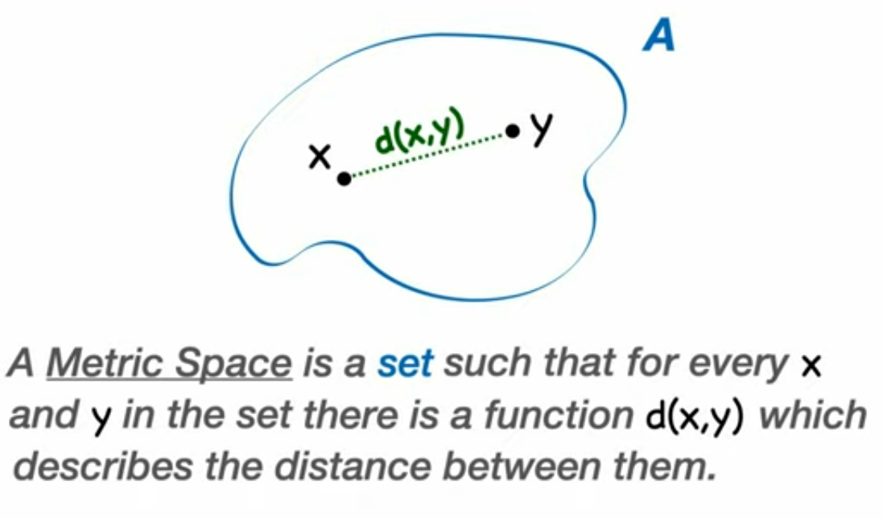
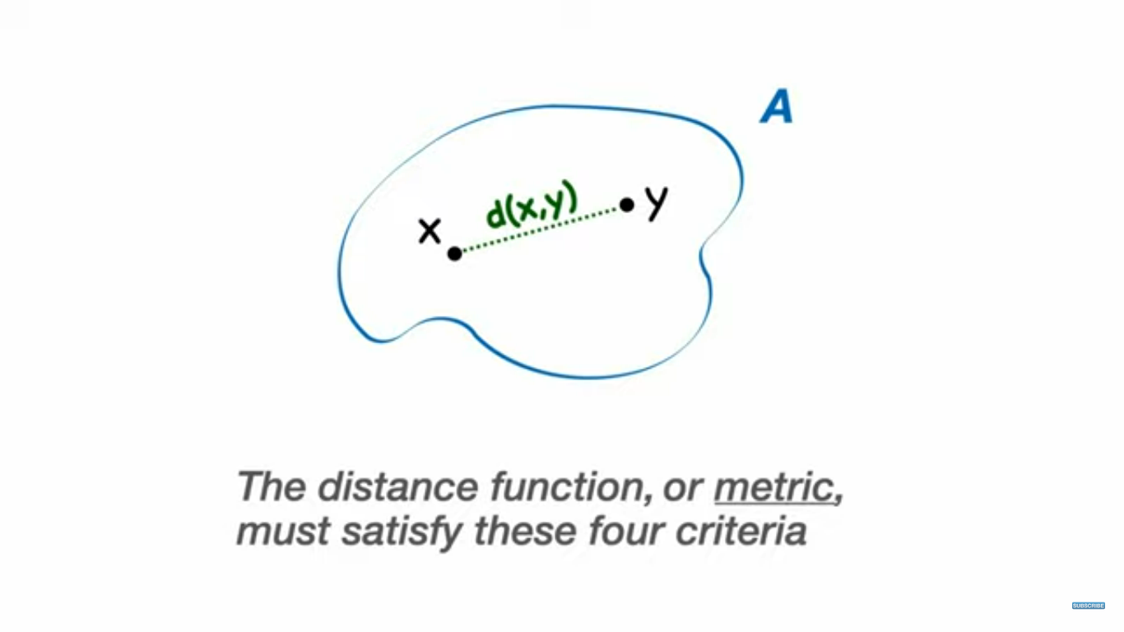

Slide 5
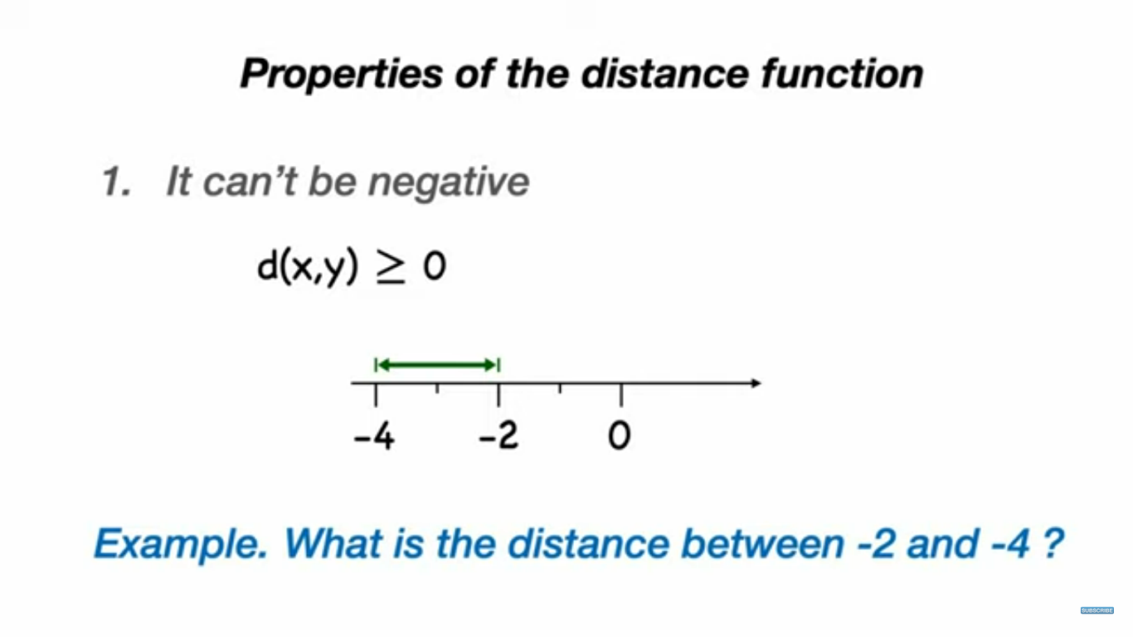

Slide 6
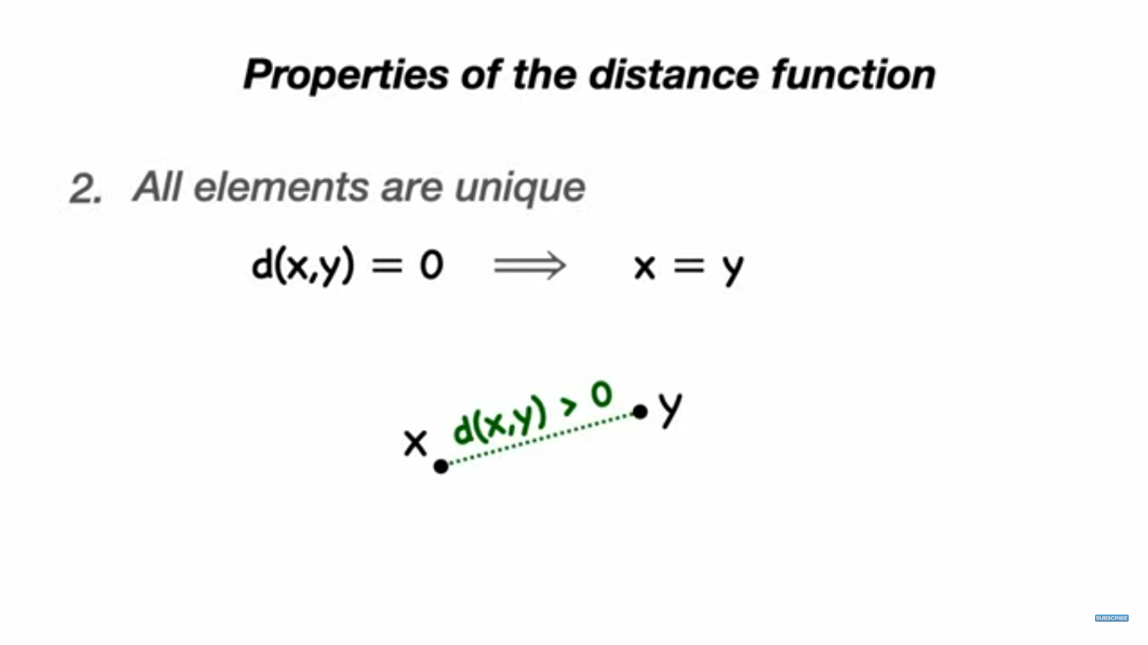

Slide 7
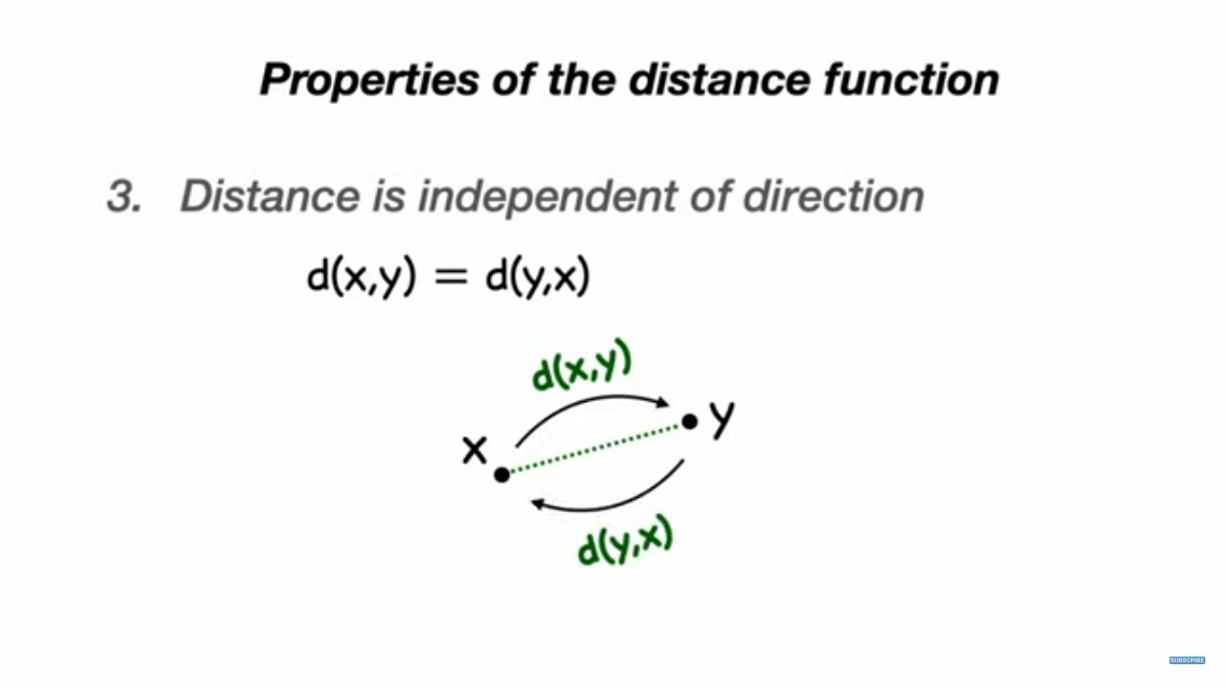

Slide 8
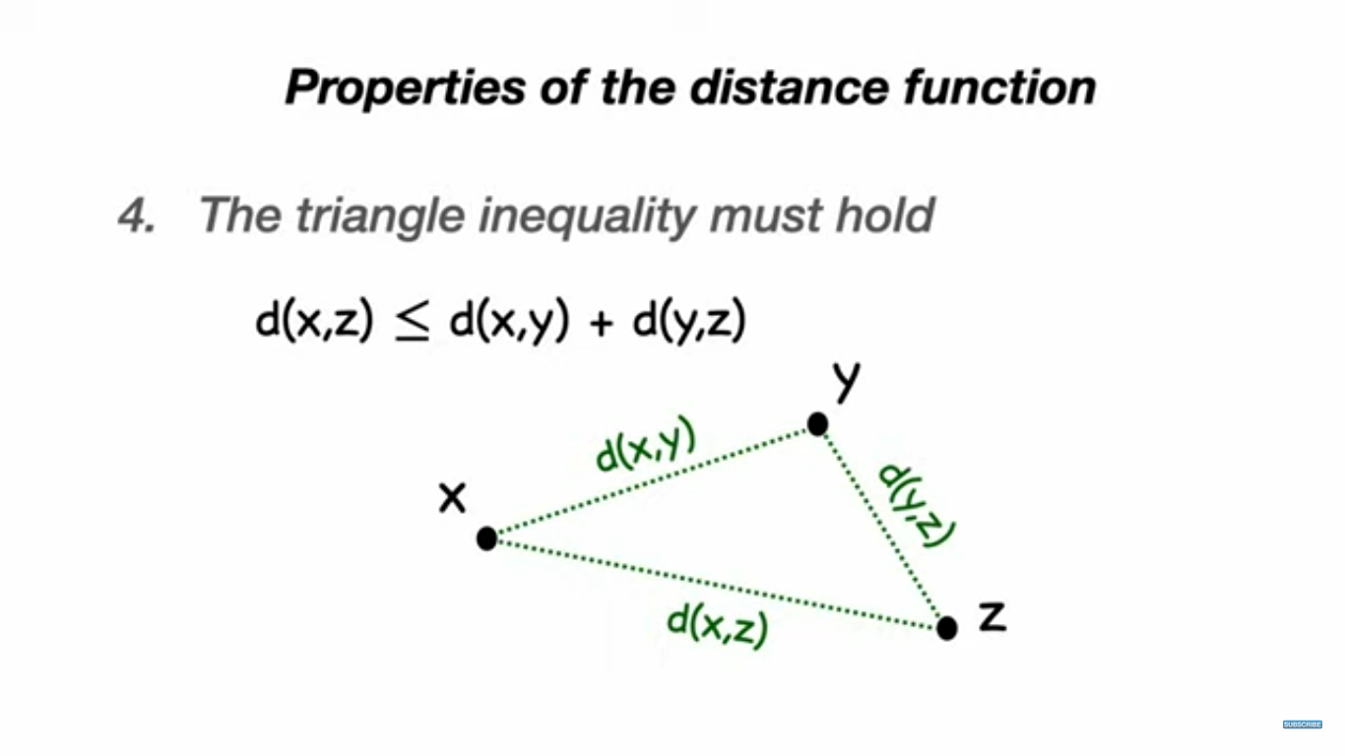

Slide 9
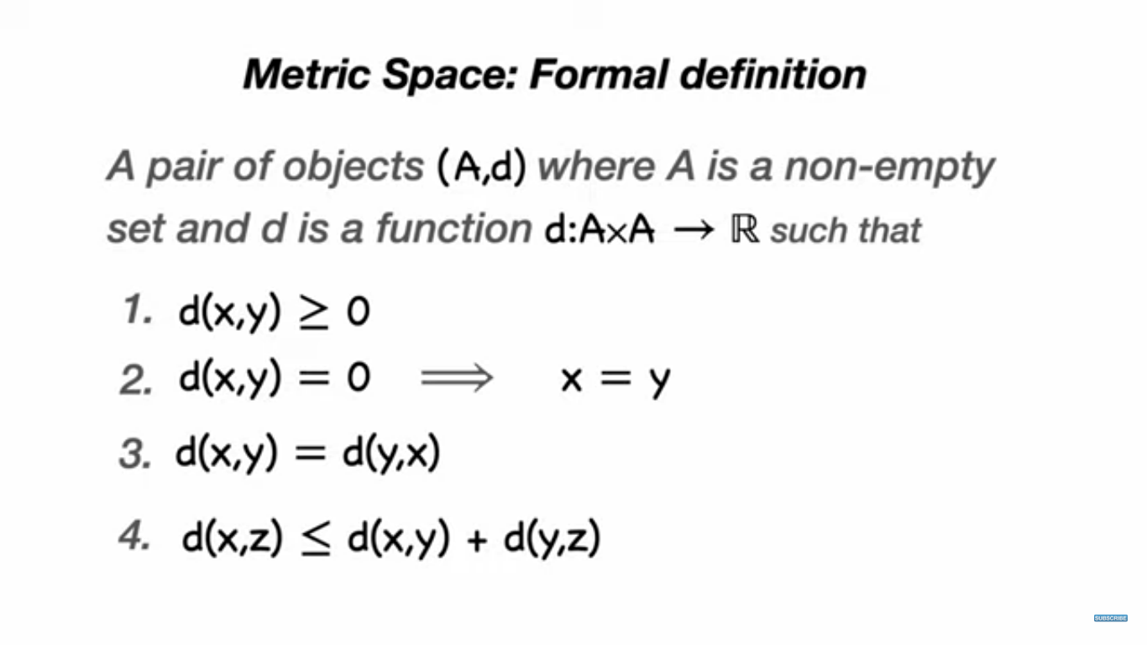

Slide 10
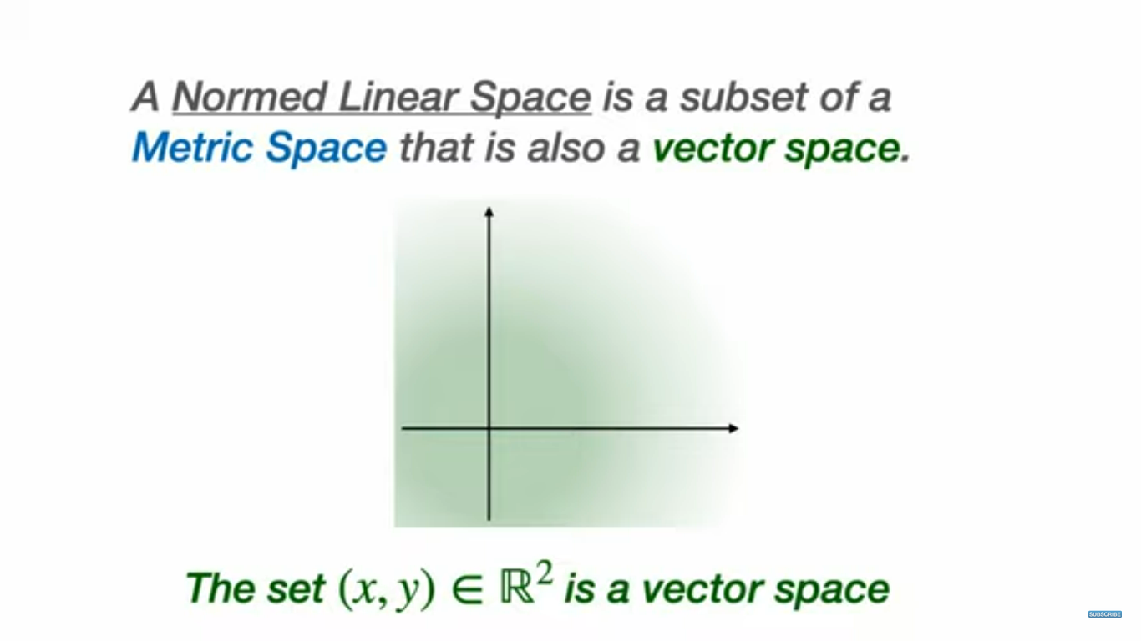

Slide 11
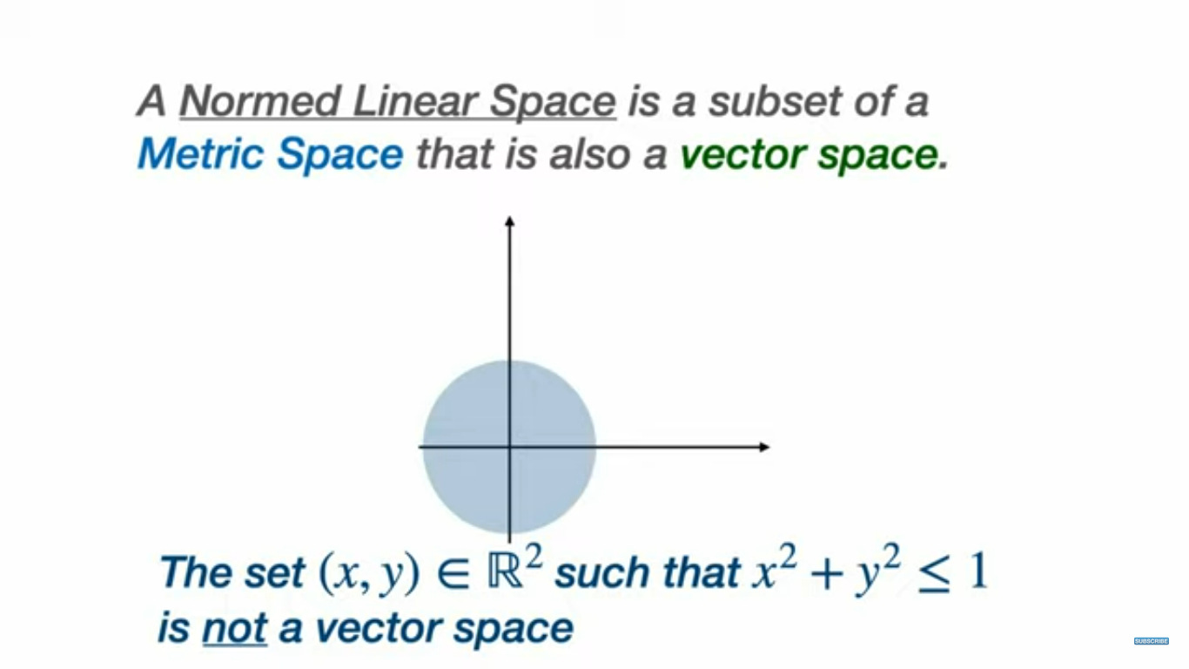

Slide 12
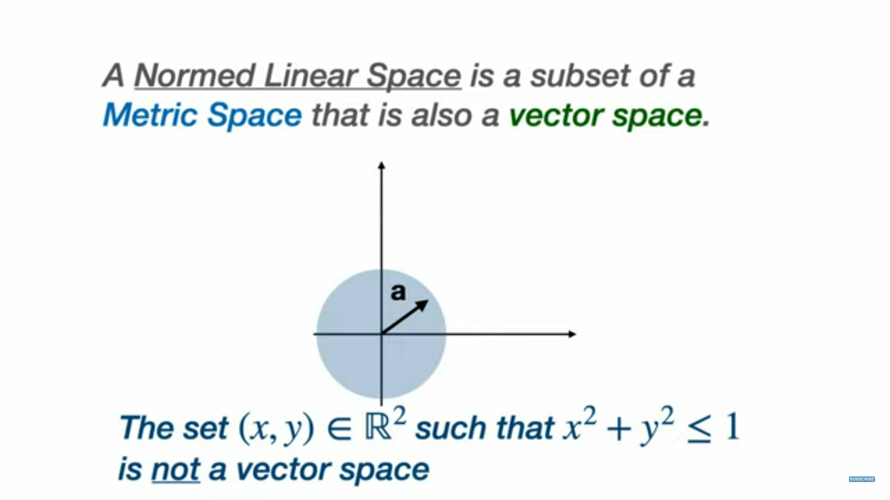

Slide 13
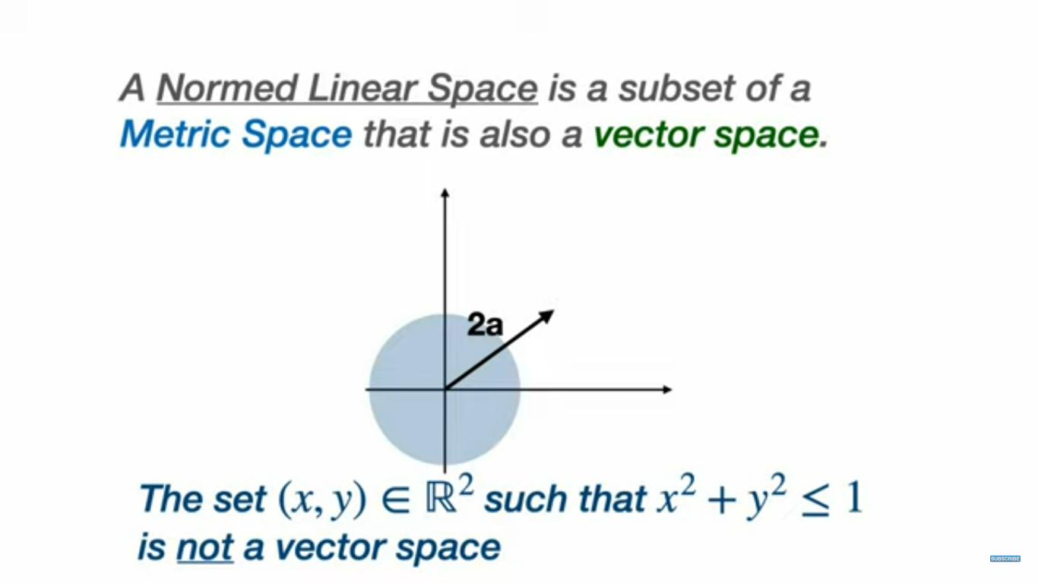

Slide 14
Norm
A norm on a vector space V denoted by ‖∙‖ is a function from 𝑉 to 𝑅
which assigns each vector x its length ‖𝑥, such that the following properties hold :
i. ‖𝜆𝑥‖ = |𝜆|‖𝑥‖ ∀ 𝜆𝜖𝑅
ii. ‖𝑥 + 𝑦‖ ≤ ‖𝑥‖ + ‖𝑦‖…….(Triangle Inequality)
iii. ‖𝑥‖ ≥ 0 & ‖𝑥‖ = 0 ,⇔ 𝑥 = 0 …………..(Positive definiteness)
Any function on 𝑉 satisfying the above properties defines a norm on that vector space.
Depending upon how the function is defined there are various types of norms

Slide 15
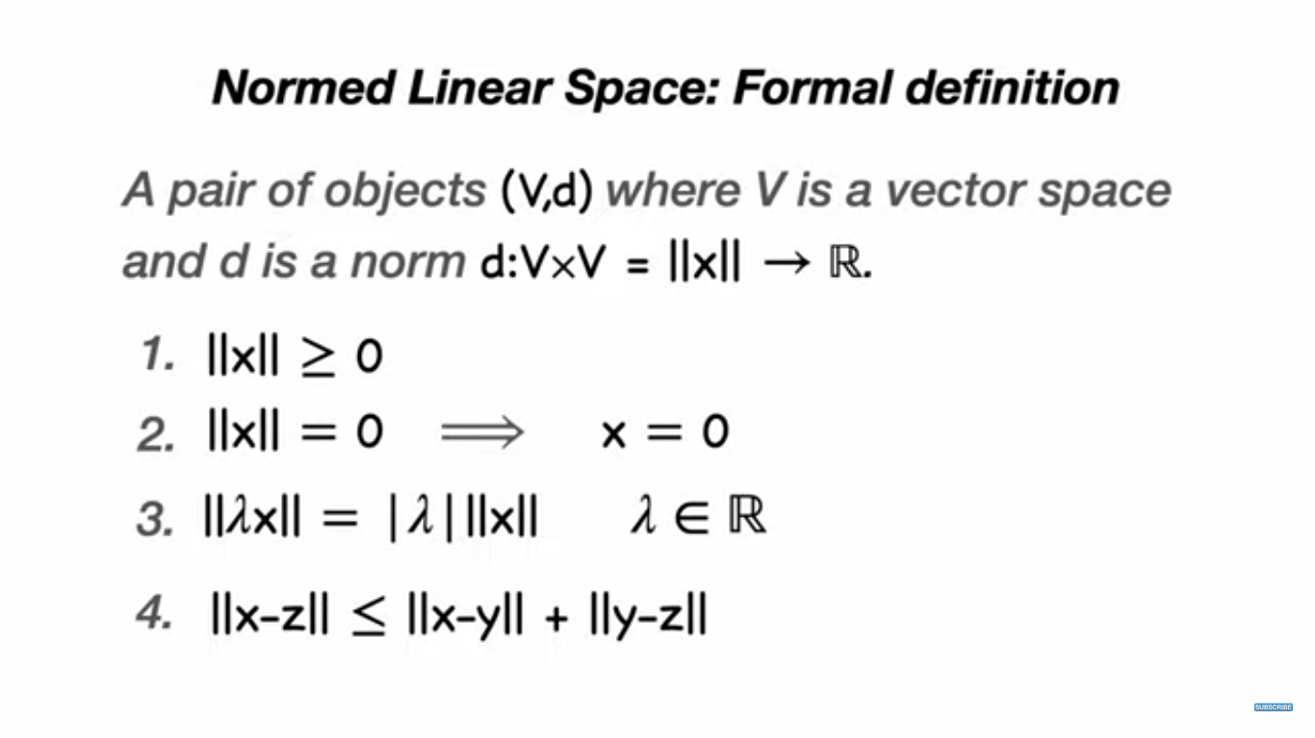

Slide 16
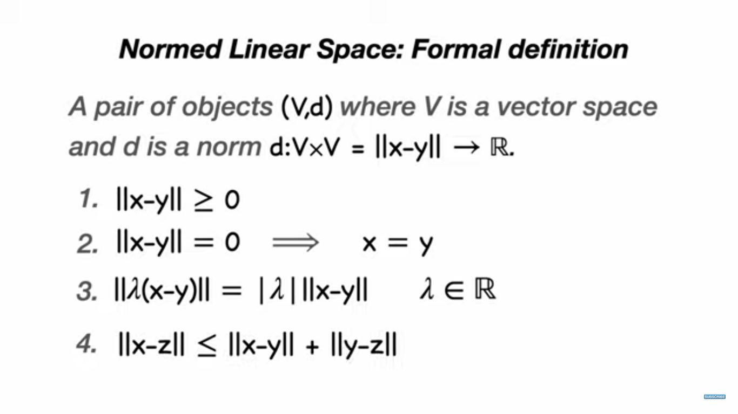

Slide 17
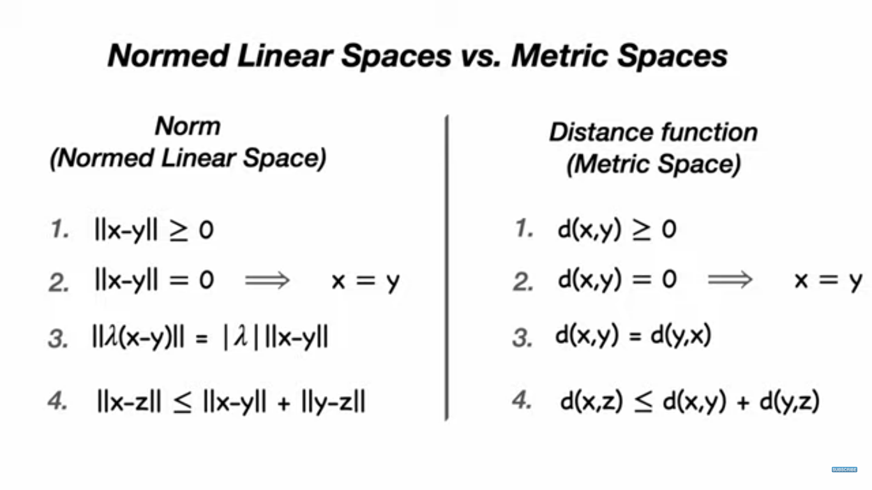

Slide 18
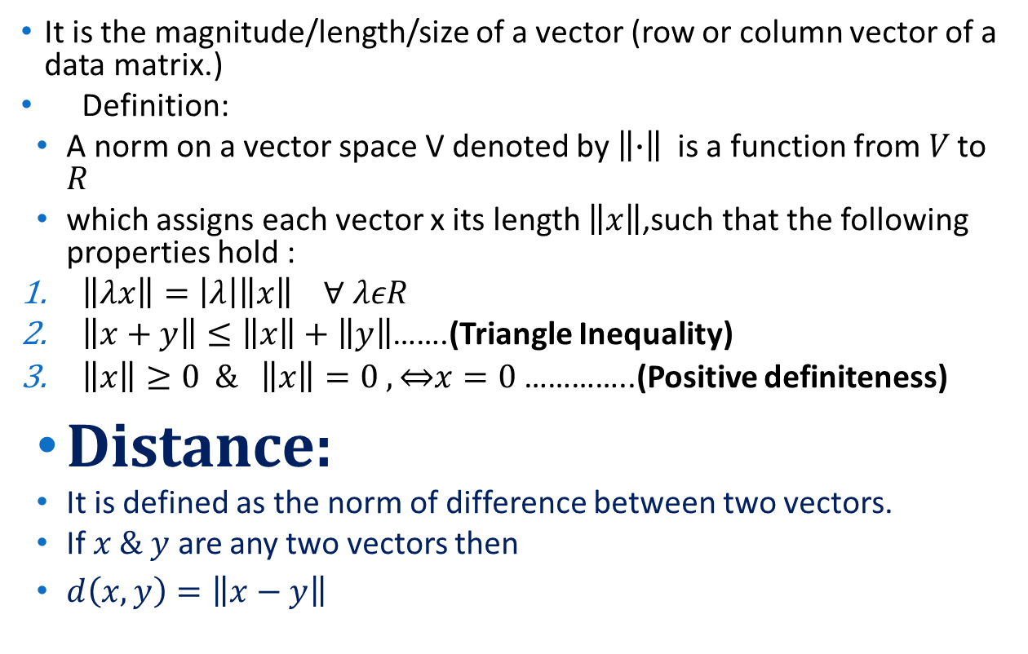
Norm
It is the magnitude/length/size of a vector (row or column vector of a data matrix.)
Definition:
A norm on a vector space V denoted by $\left\|∙\right\|$is a function from$V$ to $R$
which assigns each vector x its length $\left\|x\right\|$,such that the following properties hold :
$\left\|λx\right\|=\left|λ\right|\left\|x\right\| ∀ λεR$
$\left\|x+y\right\|≤\left\|x\right\|+\left\|y\right\|$…….(Triangle Inequality)
$\left\|x\right\|≥0 \& \left\|x\right\|=0 , \overset{⇔}{}x=0$ …………..(Positive definiteness)
Distance:
It is defined as the norm of difference between two vectors.
If $x \& y$ are any two vectors then
$d\left(x,y\right)=\left\|x−y\right\|$

Slide 19
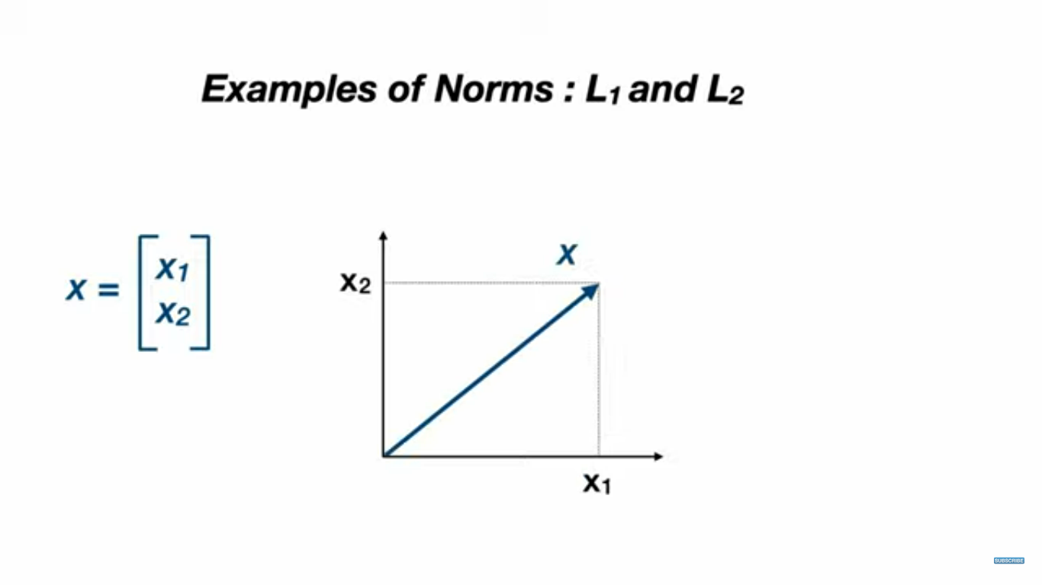

Slide 20
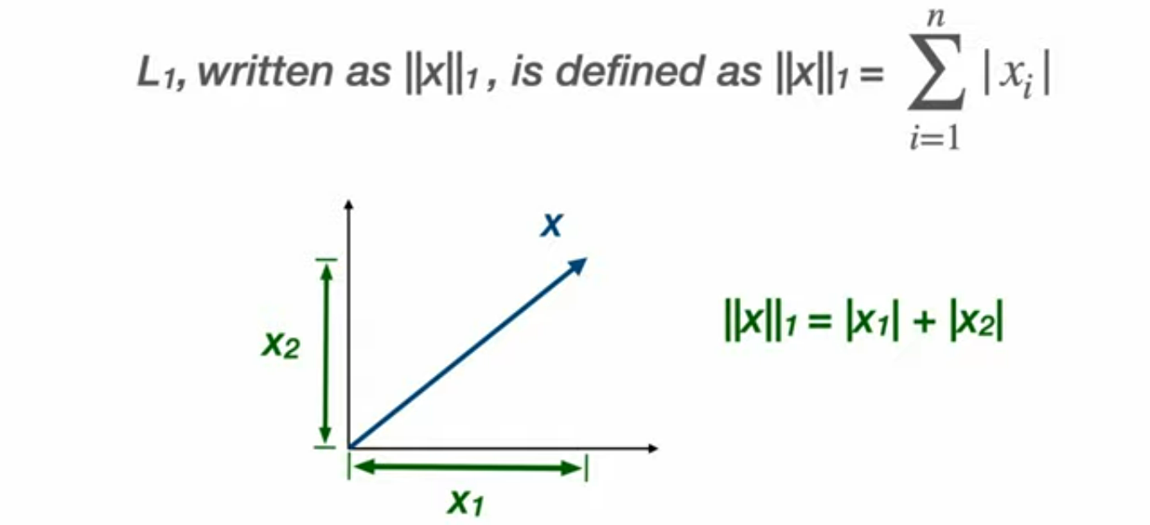
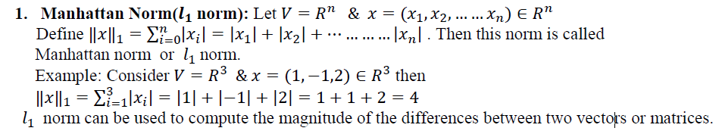
Manhattan Norm (L₁)
x=(1,2), y=(3,4)
d(x,y) = |3-1|+|4-2| = 4

Slide 21
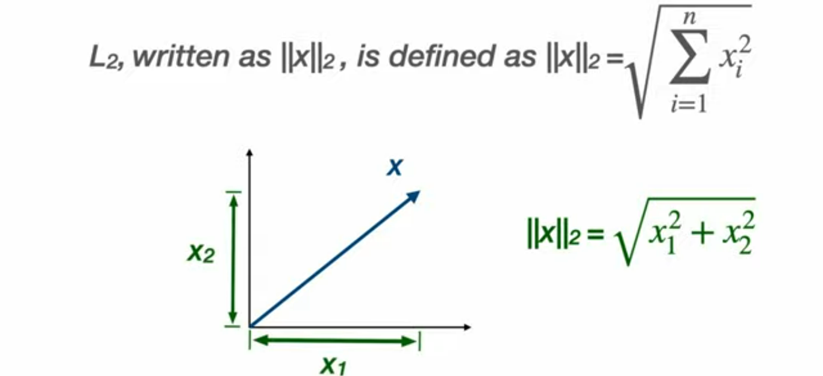
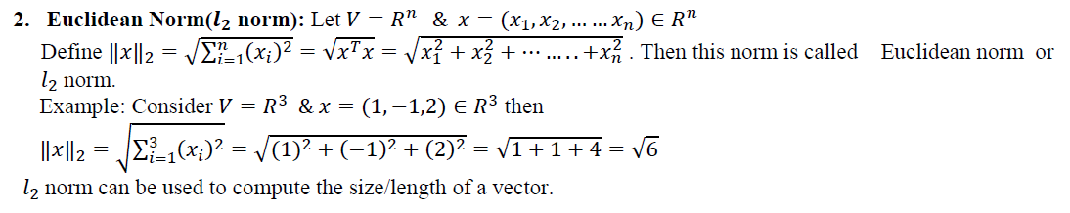
Euclidian Norm (L₂)
x=(1,2), y=(3,4)
d(x,y) = √[(3-1)²+(4-2)²] = 2.82
Notes:
RMS Value: It is used for comparing lengths of two vectors & it is defined as
$RMS\left(x\right)=\frac{{\left\|x\right\|}_{2}}{\sqrt{n}}=\frac{\sqrt{x_{1}^{2}+x_{2}^{2}+……..+x_{n}^{2}}}{\sqrt{n}}$

Slide 22

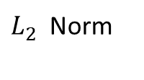

$L_{1 }vs L_{2}$ Norm
(3,4)
(1,2)
L₁ norm >= L₂ norm
L₁ norm is more robust (to outliers) than L₂ norm
L₂ norm produces stable solutions than L₁ norm

Slide 23
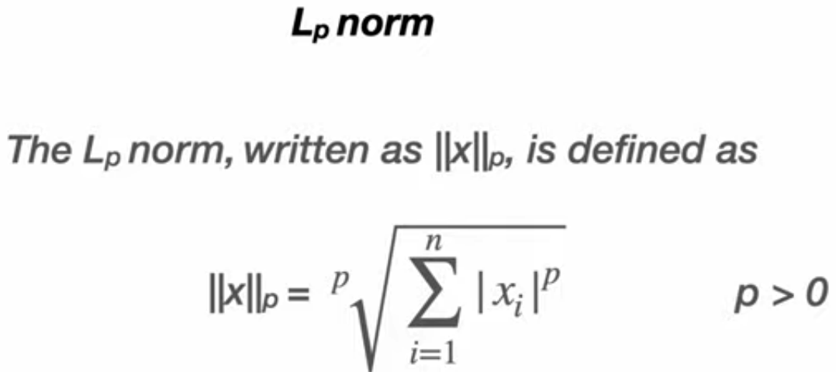
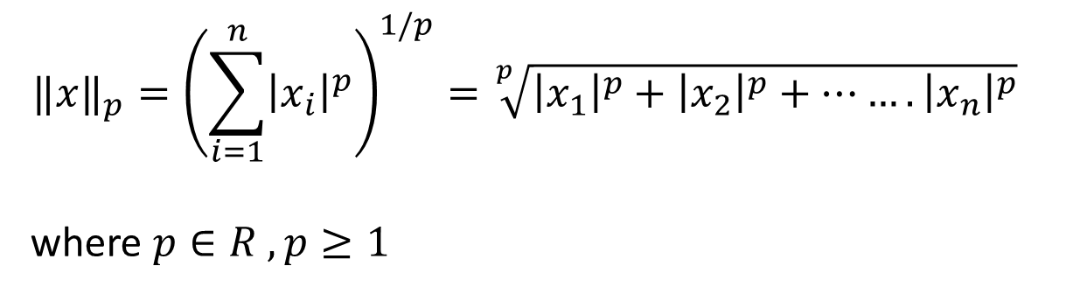
$${‖x‖}_{p}={\left(\sum_{i=1}^{n}{{\left|x_{i}\right|}^{p}}\right)}^{1/p}=\sqrt[p]{{\left|x_{1}\right|}^{p}+{\left|x_{2}\right|}^{p}+…….{\left|x_{n}\right|}^{p}}$$
where $p∈R , p≥1$

Slide 24
Applications of Norms in Data Science
To summarize or compress the information about a data vector
to a single number .
Classification Algorithms (K Nearest Neighbor – Identify Nearest Points)
Clustering Algorithms (K Means Clustering - Cluster formation) To summarize or compress the information about a data vector to a single number .
Regularization of Models - Keep coefficients of model at minimum (To find magnitude of a data point(row vector)
Optimization & Machine Learning Models – To calculate cost / loss/ profit function
Predictive Models - To compute error
Machine Learning Models - To find the loss in machine learning model

